Slide 1


Database Models and Its Types
A database model is a conceptual framework that defines the structure and organization of data in a database. It defines the relationships between different data elements and how data can be accessed and manipulated.
by Manik Mehra

Slide 2
What is a Database Model?
Data Structure
Data Relationships
Defines how data is organized and stored. It provides a logical framework for representing and managing data.
Specifies how different data elements are related to each other. It ensures data integrity and consistency.

Slide 3



Hierarchical Database Model
Root Node
1
The topmost node in the hierarchy.
Child Nodes
2
Nodes that are subordinate to a parent node.
Parent Node
3
Nodes that have one or more child nodes.

Slide 4




Network Database Model
Data Elements
Relationships
Multiple Relationships
Are represented by nodes in the network.
Are represented by links between nodes.
A data element can have multiple relationships with other elements.

Slide 5
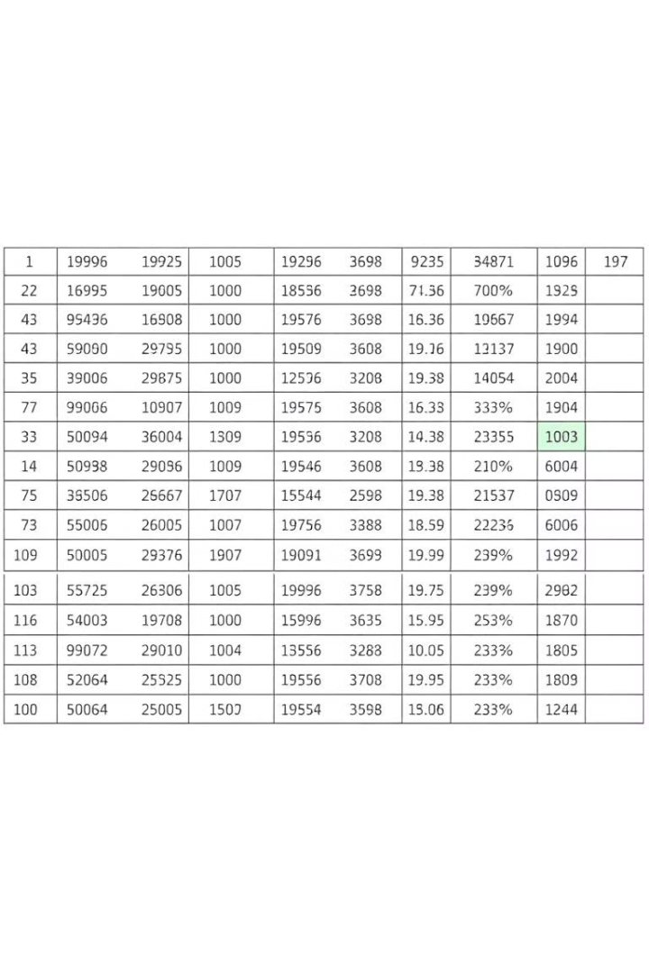
Relational Database Model
Data Organized
In tables with rows and columns.
Relationships
Defined through foreign keys, linking data across tables.
Data Integrity
Ensured through constraints and referential integrity.

Slide 6




Object-Oriented Database Model
Objects
1
Classes
Represent data and associated behavior.
2
Define the blueprint for objects.
Polymorphism
4
Inheritance
Enables objects to take on different forms and behaviors.
3
Allows for the creation of new classes based on existing classes.

Slide 7

NoSQL Database Models
Distributed
Flexible Data Models
High Availability
Can be spread across multiple servers for scalability.
Support various data formats and structures, like JSON or XML.
Provides redundancy and fault tolerance for reliable data access.

Slide 8

Key-Value Database Model
Key
A unique identifier for each data element.
Value
The actual data associated with the key.

Slide 9



Document-Oriented Database Model
Documents
Querying
Data is stored as documents, typically in JSON format.
Documents can be queried based on their content, making it efficient for complex queries.

